Slide 1
CWU Horn Ensemble
SOURCE 2019

Slide 2
CWU Horn Ensemble
The Central Washington University Horn Ensemble is made up of university students, regardless of major, interested in playing the horn.
The CWUHE performs 1- 2 full concert programs per year, has released two Christmas CDs, and has been featured at Northwest Horn Society workshops, Washington Music Educators Association conferences, and symposia of the International Horn Society (in 1996, 1998, 2001, 2008, 2011, 2014, and 2018).
In 2018, the ensemble placed second in the IHS 50 Ensemble competition at Ball State University in Muncie, Indiana.
The ensemble also maintains an active outreach program, promoting the horn and its music in Washington's schools.
Performed at the 2019 Northwest Horn Symposium, March 29-31, at the University of Montana. This presentation features some of the pieces performed at this symposium.

Slide 3
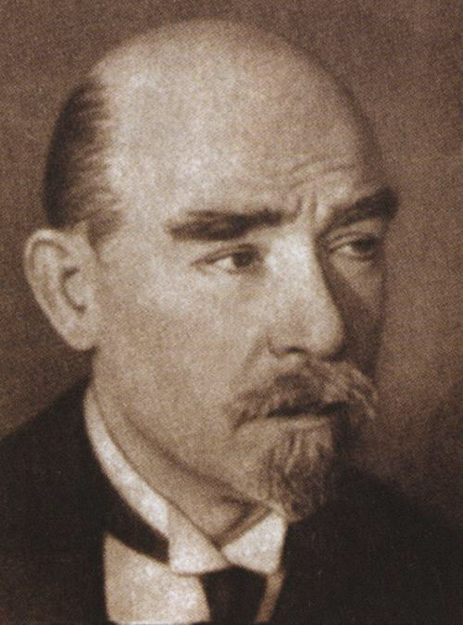
Salvation is Created by Pavel Chesnokov
Choral piece arranged by Richard Price
Composed 1912
Classic Russian hymn that is known for use of complimentary major and minor keys and power chords.
Translated to “Salvation is made in the midst of the earth, O God. Alleluia.”
Has been arranged for multiple ensembles—great with “like” instruments
Conducted by Sophie Mortensen

Slide 4
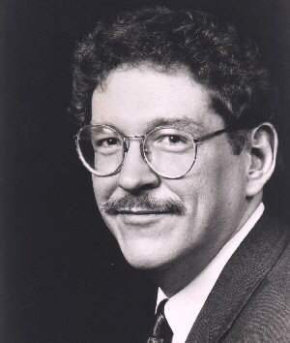
At Home on The Western Shore by Erik Ewazen
Composed in 2001
First movement of a larger work, The Legend of the Sleeping Bear
Based on a Native American legend about the Sleeping Bear dunes near Lake Michigan.
This movement is about the bear cubs playing near the lake as their mother watches.
Conducted by Amanda McDaniel

Slide 5
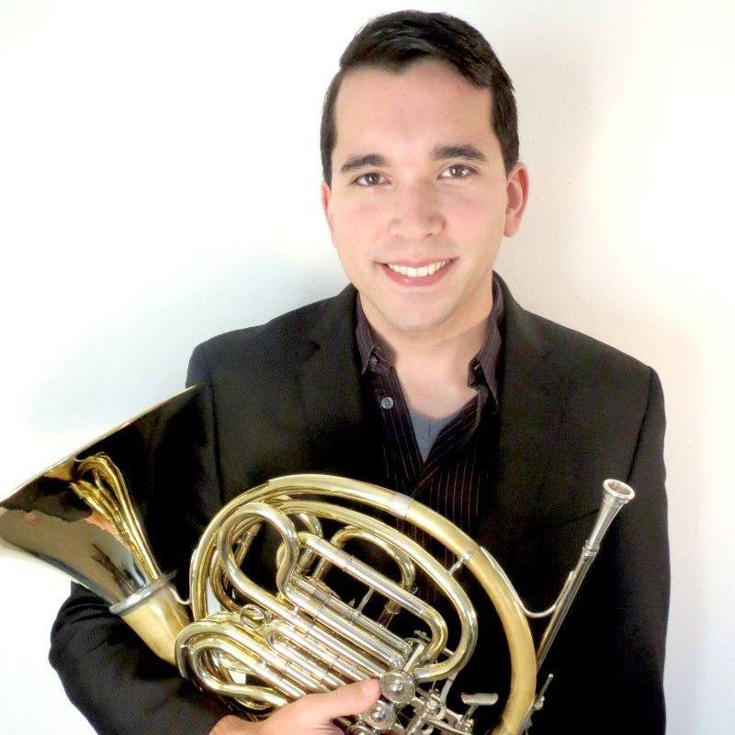
Jubilee by James Naigus
Composed in 2011
A fanfare type celebration
Use of mostly major chord progressions to indicate happiness and jollity
Layering different meters to create contrast
Conducted by Douglas Focht

Slide 6
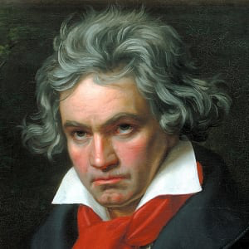
Symphony No. 5, op. 67 by L. v. Beethoven
Originally for full orchestra, arranged for horns by Keith Campbell
Composed 1808
1st Movement (of 4)
Written when Beethoven was beginning to lose hearing
Full symphony sought to express a personal journey from relentless internal struggle to pure joy.
Conducted by Evan Hagen

Slide 7
CWU Horn Ensemble Members 2019
Joseph Bagdovitz, sophomore
Christopher Brown, freshman
Rand Carter, freshman
Gabrielle Charles, junior
Laura Cornwell, freshman
Solveig Dahl, senior
Douglas Focht, junior
Evan Hagen, junior
Amanda McDaniel, junior
Nathan Miles, junior
Sophie Mortensen, senior
Henry Nordhorn, sophomore
Kyle Olsen, sophomore
Jaya Swayam, sophomore
Allison Wenzel, freshman
Dr. Jeffrey Snedeker, director/advisor

Slide 9
Thank you!
Special Thanks to Our Supporters:
CWU Career Services, CWU Office of Undergraduate Research, CWU Student Academic Senate, CWU Club Senate, CWU Services and Activities Committee, and CWU Music Department

