Slide 1
How I Started a Music Festival at CWU:
Networking, Budgets, Artistry
Peregrine Spane

Slide 2
How I Started a Music Festival at CWU:
Networking, Budgets, Artistry
Peregrine Spane
Notes:
I can only speak to the extent that I was involved with: Music Industry Club, the original idea, local artist curation input, music industry panel.

Slide 3
Advisors and Other Key People
CWU Individuals
Dr. Mark Samples – Advisor
Robbi Goninan – Head of Campus Activities
Lawrence Danton – Consultant
Industry Professionals
Portia Sabin – Record Label President, Mentor
Christen Greene – Artist Manager, Mentor
Adam Zacks – Founder of Sasquatch! Music Festival
Cheryl Waters - DJ at KEXP Seattle
Notes:
None of this would have happened without Robbi and Campus activities, specifically students Libby Akin, and Ronnie Hindman.

Slide 4
Definitions
Independent (indie) – An artist that is not sponsored or supported by a corporation or parent company.
Scene
“Its a landscape of art in your community…” – Cheryl Waters, KEXP
“I think it boils down to coalescing a group of people with shared values.” – Adam Zacks, Seattle Theater Group
Notes:
"Its a landscape of art in your community, there can be scenes within scenes, it’s everything that is going on with subcultures within that...a group/community of people speaking from their heart and creating art and sharing it with one another. its really important to have other people in your community that you can learn from and grow from and that you can be vulnerable and safe around" - Cheryl Waters KEXP
I think it boils down to coalescing a group of people with shared values. This often requires a focal point, like a music festival, for people to find each other and share a meaningful real world experience to forge the initial bonds that eventually gain momentum and create the building blocks of a "scene". -Adam Zacks

Slide 5
Vision
Multi-stage event
Headliner
Local artists: Seattle/PNW
Under-represented areas (genre, race, gender, etc)
Industry Panel
Independent Focus

Slide 6
Observable Needs
More Inclusive Representation
Closer Gender Parity
Genre
Local college radio programing
Focus on Independent Music
Provides opportunities to local individuals
“Building community and placing a high value on music discovery” – Adam Zacks
Stronger Local Scene
Notes:
Closer gender parity is an issue that has risen to prominence in the music industry over the last few years. It has been featured in the Portia Sabin Podcast the Future of What multiple times. On episode___, Label president Jen Chloer notes that this is a problem in Australia, and there is an instagram account lineups without males that shows a before and after pictures of festival line ups. One picture has the full lineup, one has the male led artists removed.
Of lineups posted in the last year, 48/70 (69%) of lineups have less than 50% women. of those 48, 23 (48%) have less than 25% women represented, and 4 of those 48 posts have 0% women.
Independent Focus
"booking a non-commercial line up is a statement that this is not simply a commercial venture for the purpose of maximizing profits, but rather an event with a higher purpose- building community and placing a high value on music discovery." -Adam Zacks
Lack of a local scene
-lack of visibility for independent radio
-few venues (there are establishments in ellensburg that have the capability of being a venue, but do not use it as one)
-apart from the ocassional open mic nights, there are few outlets for artists to perform/share their creative expression

Slide 7
Scene Building
What would be evidence of a scene in Ellensburg?
more gigs, observable-> advertisements
independent programming on campus radio
space where independent artists can congregate
How does this celebration build a scene?
Focal point for people to congregate, meet, share – Adam Zacks
Notes:
What would be evidence of a scene in ellensburg?
-more giges, observable-> advertisements
-independent programming on campus radio
-space where independent artists can congregate
Scene is dormant (unfocused), somethings are in place, what we need to do is cultivate. Coalese, need them to be stronger
How does this celebration build a scene? –ellensburg artists

Slide 8
Origins/Timeline
January 2018
Brought idea to Dr. Samples; said “No”
Brought idea to Academic Advisor; “No”
April/May 2018
Spear-headed guest speaker event
Brought Idea to Robbi; big yes
Dr. Samples now convinced
Notes:
What I realized is that a project this big was way outside of the typical scope of a senior project.
It took diligence and credibility built up over time to convince important stake holders of my ability to complete the project.

Slide 9
Origins/Timeline
June/July 2018
Consultation with Lawrence Danton
August 2018
Meeting with Portia Sabin
Mercer & Summit Block Party - Christen

Slide 10
Origins/Timeline
September/October 2018
Start having weekly meetings with Campus Activities
November 2018
First music industry workshop – what eventually becomes Music Industry Club

Slide 11
Origins/Timeline
January 2019
Start scouting for PNW artists, send Robbi my shortlist.
February 2019
PNW artists are contacted
Start Music Industry Club
Solidify industry panel lineup

Slide 12
Origins/Timeline
March/April 2019
Request and get approved $1,500 for panel from club senate
Contracts for headliner and local bands get finalized
Student artists audition for lineup space
Hype materials released
I interview Cheryl Waters, KEXP
I interview Adam Zacks, STG/Sasquatch!

Slide 13
Origins/Timeline
May 2019
Standard agreement forms written up for panel
Final logistics being worked out

Slide 14
Minimum Viable Product (MVP)
1 Stage
4 Acts
Industry Panel
Location: SURC

Slide 15
Event Final
2 Stages
Headliner
3 Seattle artists
5 student performers
Panel of industry professionals
Location: Rec. sports complex

Slide 16
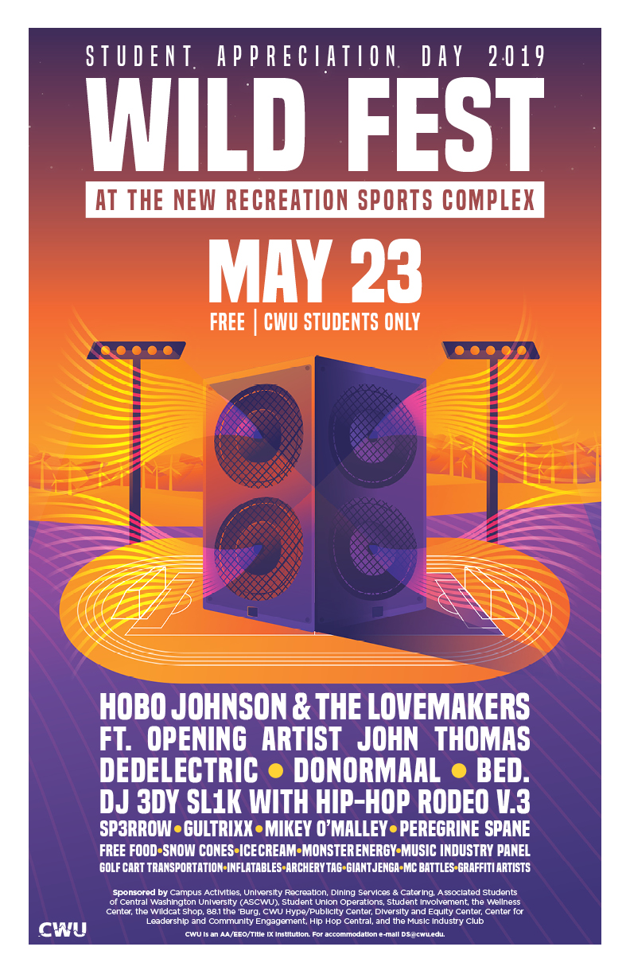

Slide 17
Budget
 | Contract: Hobo Johnson | $20,000.00
 | Degy Entertainment | $2,000.00
 | Flame-Tech Rider (Lighting & Sound) | $11,343.96
 | Publicity-Marketing, Posters, Handouts | $1,500.00
 | Contract: BED | $1,850.00
 | Contract: Ded Electric | $600.00
 | Contract: DoNormaal | $1,000.00
 | SURC Operations (setup & sound) | $800.00
Student Appreciation 2019 | Campus Police: | $1,000.00
May 23, 2019
$42,500.00 | Hip Hop Rodeo: Trophies (wildcat shop) | $97.48
 | Hip Hop Rodeo: Grafitti Artists | $1,000.00
 | DJ Edy Sl1ck | $450.00
 | FMD. Stage rental, setup, stage, power | $2,000.00
 | Artist Green Room | $250.00
 | DJ Soulrane Contract | $800.00
 | Student Government Funding Support | ($6,200.00)
 | SI & SU Help | ($3,000.00)
 | SI (SoulRane DJ) | ($800.00)
 | Recreation Support | ($2,000.00)
 | DEC Support (MC Judges) | ($500.00)
 | Motorpool: Golf cart rental | $20.00
 | Motorpool: Van Rental | -
 | Contract: MC Judges | $500.00
 | Misc. Expenses: Photobooth | $525.00 |  | Remaining Balance
 | Misc. Expenses: EntryWay, Sunscreen, Misters | $220.05 |  | $3,196.82
 | Misc Expenses: Giveaways (Sunglasses) | $1,557.78
 | Oxarc-CO2 Cannisters | $103.91
 | Advanced Experience (co2) | $685.00
 | Misc Expenses: Water Bottles/Cups | $500.00
 | Dining Services (food truck) | $3,000.00
 | Total | $39,303.18
Notes:
Campus Activities receives funding from Student & Activities Fee which allows us to plan events and programs for CWU Students.
Yellow are not finalized charged, but estimates. The red are credits, donations made towards the event from different departments on campus.

Slide 18
Where to Go in the Future
Closer gender parity
Increased involvement from Music Department
Involvement as visibility
Sponsoring panel/artist/discussion
Volunteers
Maintain independent scope
Continues original mission: scene building.
Notes:
Closer Gender Parity in artist lineup
- my internal goal was to get into the 50% mark, and we didn't make it.
-the I have a clearer picture on when you try to achieve gender parity, it doesn't always workout the way you hope.
-2 out of 9 performers were women
Increase involvement of music department
-natural partner for a music event
Maintaining independent scope
By maintaining the original independent integrity of the event, we can continue to build an ellensburg scene.
-what helps build a scene? Commercial artists or independent artists

Slide 19
This event was by students, involved students (logistically, performance, etc.), and for students.

Slide 20
How I Helped Start a Music Celebration at CWU:
Networking, Budgets, Artistry
Peregrine Spane

