Slide 1
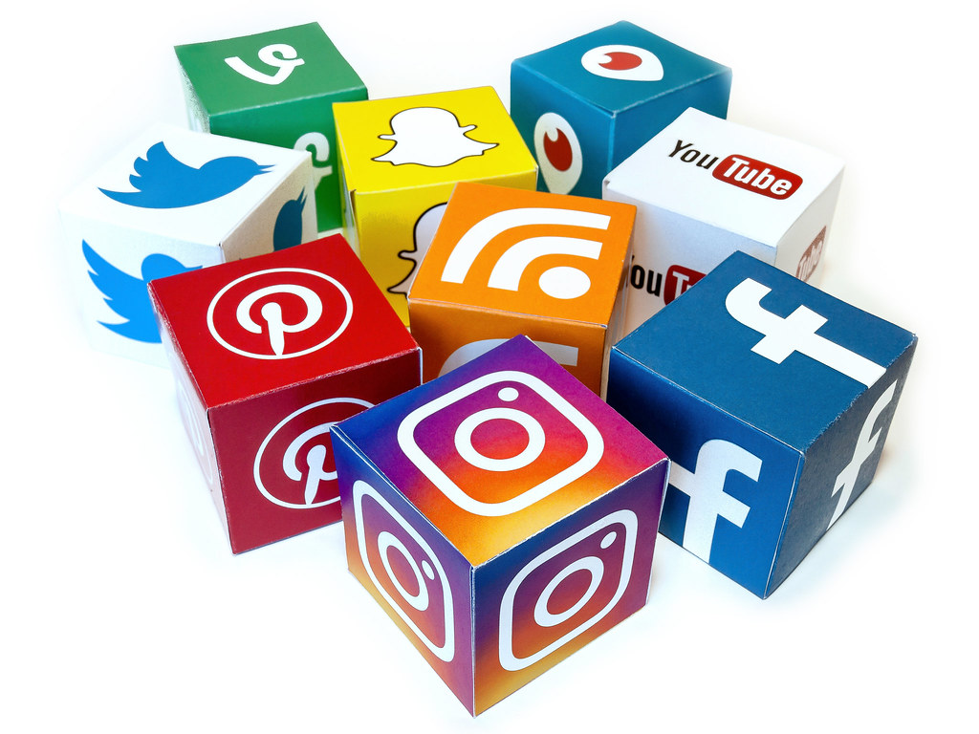
Considering Social Media Art on YouTube:
Exploring a new understanding of online content and content creators.

Slide 2
Why social media? Why YouTube?

Slide 3
YouTube: The Numbers
YouTube was created in 2005.
Marketed as a simple and private video-sharing platform.
The start-up was purchased by Google in 2006 for $1.65 billion.
Approximately 400 hours of video is uploaded to the site every minute.
A top content creator today can make between $30,000 and $500,000 a month on ad revenue, brand deals, and merchandise sales.
Currently, there are approximately 23 million YouTube channels.
Each one of those channels independently produces unique content for a niche audience.

Slide 4
Example: The Vlog Brothers

Slide 5
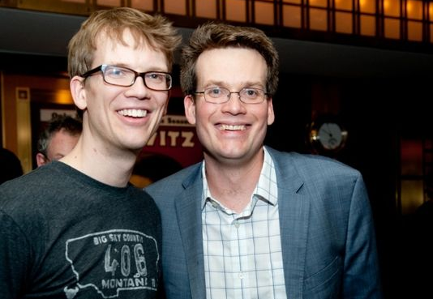

Slide 6
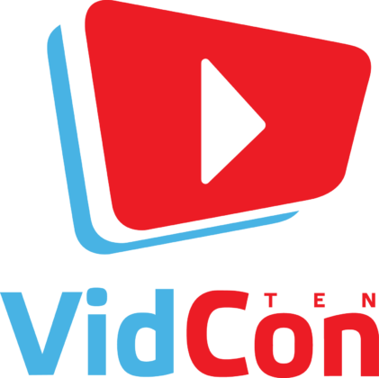

Slide 7
VidCon is an annual convention where content creators and fans meet to celebrate YouTube, social media, and internet culture.
Attendees can participate in three separate convention tracks: community, creator, or industry.
It was acquired by the major media conglomerate Viacom in 2017.
In 2017, there were more than 30,000 attendees.

Slide 8
The contributions online content creators are making are often overlooked by academia.

Slide 9
Content creators are reaching audiences that have not been reached before.
They are using cross-platform marketing techniques to increase connection to their communities.
They are using technology in innovative ways to
communicate ideas unique to the online generation.
They define what is possible online.
They are multidisciplinary artists who create for online platforms intentionally.
They understand and create with a nuanced understanding of the technological limitations of their audiences.
They are establishing the rules of online etiquette and digital social standards.

Slide 10
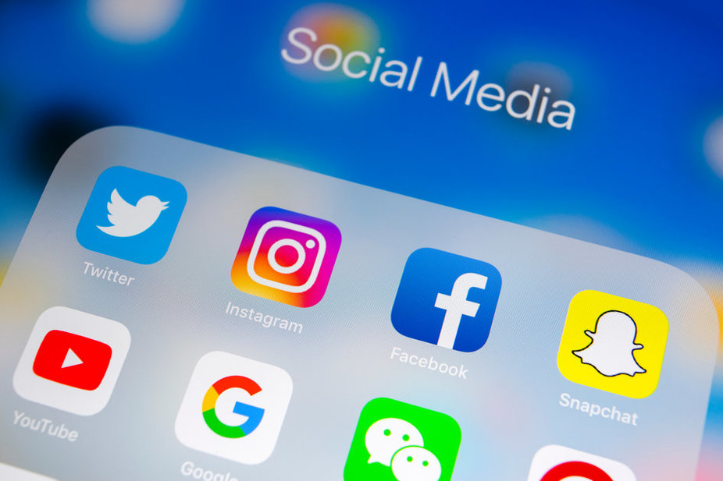
Thank you!

