Slide 1
Dance is a Language
Katelyn Stewart

Slide 2
Words Lost in Translation
Fargin- (Yiddish) To wholeheartedly appreciate the success of others
Fisselig- (German) Being flustered to the point of incompetence
Yūgen- (Japanese) Means “a profound, mysterious sense of the beauty of the universe … and the sad beauty of human suffering”
Razbliuto- (Russian) Describes the feeling a person has for someone he or she once loved

Slide 3
Dance to Bridge the Gaps
Choreographic tools
Bodily movement styles
Relationships between dancers
Facial Expressions
Collaborative Nature of Dance
Utilizing other art forms

Slide 4
Common Ground
Dancers: Marissa Bragg, Katelin Smith-Rockne
Music: Slow Down- Scott Orr
Choreography: Katelyn Stewart

Slide 5
Common Ground
Characters
Marissa- Myself
Katelin- Younger sister
Dynamics of a sisterly relationship
Loving / Playful
Argumentative
Supportive
Protective

Slide 6
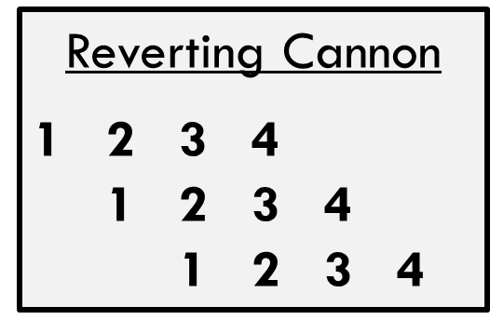
Common Ground
Big sister vs. Little sister
Intention (Effort)
Younger sister- thrown, messy; older sister- intentional, crisp
Follow the Leader
Reverting/ overlapping cannon
Monkey see monkey do
Staging
Disagreements
Focus
Playful- chasing
Support

Slide 7
Choreographers Tools: Elements of Dance
Time
Space
Energy
Effort

Slide 8
Time
Definition:
Timing
Stillness
Syncopation
Speed
Application
Fast vs. Slow

Slide 9
Space
Definition
Large and Small movements
Levels
Shape
Facing
Application
Large vs. Small movements
Use of Space

Slide 10
Energy
Definition
Soft and Sharp
Wind blown leaves vs. crack of whip
Suspension
Application
Soft vs. Sharp

Slide 11
Effort
Application
Thrown vs. Articulate
Definition
Thrown vs. Articulate
Inflatable at car dealership vs. Hands of a pianist
Push and Pull

Slide 12
Characters
Trio performance
Tyler Lovie
Change of meaning
Little change in choreography

Slide 13
Collaborative Nature of Dance
Music/ Sound
Poetry
Costuming
Lighting Design

Slide 14
Conclusion & Questions
Thank you!

Slide 15
References
Argane, Hiba. "Lost In Translation: 30 Words With No English Equivalent". Lifehack, https://www.lifehack.org/articles/lifestyle/lost-translation-30-words-with-english-equivalent.html. Accessed 13 May 2019.
Argane, Hiba. "Lost In Translation: 30 Words With No English Equivalent". Lifehack, https://www.lifehack.org/articles/lifestyle/lost-translation-30-words-with-english-equivalent.html. Accessed 13 May 2019.
Blom, Lynne Anne, and L. Tarin Chaplin. The Intimate Act Of Choreography. University Of Pittsburgh Press, 1982.

